Slide 1


Machine learning algorithms based prediction of Botnet Attacks for IOT Devices
Department of Cyber Security
III B.Tech I Semester MiniProject-2023
Submitted by
(Team-10)
Team-10​
21r21A6208 – B.Jeevan Naik
21r21a6229 – K.Sujith reddy
21r21A6233– m.kiran NarsimhA
21r21a6242 – P.sahasra
21r21a6247 – s.Haripriya
21r21a6248 – sahil jadhav
Guide: Ms.Tejaswini
Assistant Professor.

Slide 2
Contents
Abstract
Introduction
Existing System & it’s drawbacks
Problem statement
Proposed System
ADVANTAGES
OBJECTIVES
REQUIREMENTS
CONCLUSION
SCOPE
Literature survey
REFERENCES

Slide 3
Abstract
There are an increasing number of Internet of Things (IoT) devices connected to the network these days, and due to the advancement in technology, the securitythreads and cyberattacks, such as botnets, are emerging and evolving rapidlywith high-risk attacks. These attacks disrupt IoT transition by disrupting networks and services for IoT devices. Many recent studies have proposed ML and DL techniques for detecting and classifying botnet attacks in the IoT environment. This study proposes machine learning methods for classifying binary classes i.e., Benign, or TCP attack. A complete machine learning pipeline is proposed, including exploratory data analysis, which provides detailed insights into the data, followed by preprocessing. During this process, the data passes through several fundamental steps. A random forest, k-nearest neighbour, support vector machines, and a logistic regression model are proposed, trained, tested, and evaluated on the dataset. In addition to model accuracy, F1- score, recall, and precision are also considered

Slide 4

Introduction
The general idea of the Internet of Things (IoT) is to allow for communication between human-to-thing or thing-to-thing(s). Things denote sensors or devices, whilst human or an object is an entity that can request or deliver a service [1]. The interconnection amongst the entities is always complex. IoT is broadly acceptable and implemented in various domains, such as healthcare, smart home, and agriculture. These constraints create problems in providing and implementing a security solution in IoT devices. These constraints further escalate the existing challenges for IoT environment. Therefore, various kinds of attacks are possible due to the vulnerability of IoT devices.
The escalating threat of botnet attacks on Internet of Things (IoT) devices has spurred the adoption of machine learning algorithms for predictive defense mechanisms. Decision trees, random forests, support vector machines, and neural networks are common choices. Training and evaluation phases assess model performance, with metrics such as accuracy and precision.

Slide 5
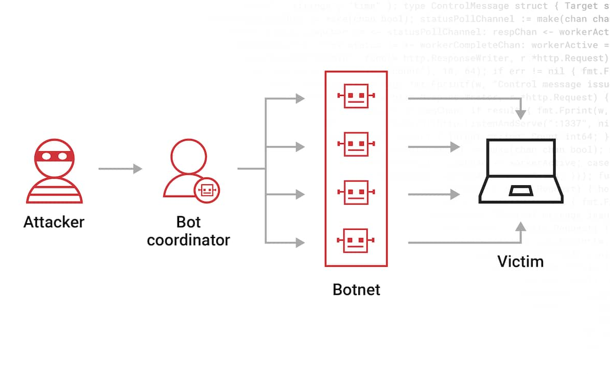
Botnet
What is Botnet?
A botnet is a network of compromised computers or devices, often connected to the internet, that are controlled by a single entity or command center. These compromised devices, known as "bots" or "zombies," are typically infected with malicious software, allowing the attacker to remotely control them without the owners' knowledge.
How Botnet Works?
In the P2P botnet approach, the infected devices scan for malicious websites or other devices. The bot carefully probes random IP addresses until it comes in contact with another infected machine. The bots then share updated commands or the latest versions of the malware.

Slide 6
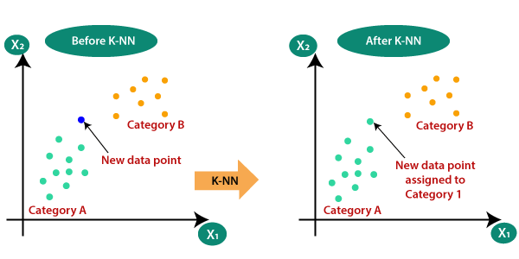
Existing System
K-Nearest Neighbor (KNN)
K-Nearest Neighbour is one of the simplest Machine Learning algorithms based on Supervised Learning technique. K-NN algorithm assumes the similarity between the new case/data and available cases and put the new case into the category that is most similar to the available categories. KNN algorithm at the training phase just stores the dataset and when it gets new data, then it classifies that data into a category that is much like the new data.

Slide 7
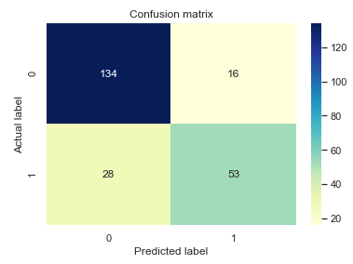
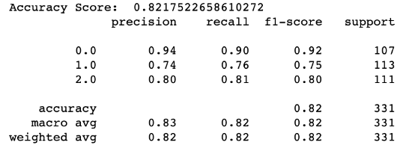

Drawbacks
Limitations of the Existing System:
Accuracy depends on the quality of the data.
With large data, the prediction stage might be slow.
Require high memory – need to store all of the training data.
Evaluation Metrics:

Slide 8
Problem Statement
Securing IoT devices from botnet attacks is a pressing challenge due to their resource constraints and dynamic nature. Traditional security measures fall short, necessitating advanced solutions. We need smarter solutions. This study focuses on using machine learning to predict and stop botnet attacks early, securing IoT devices and keeping them running smoothly.

Slide 9
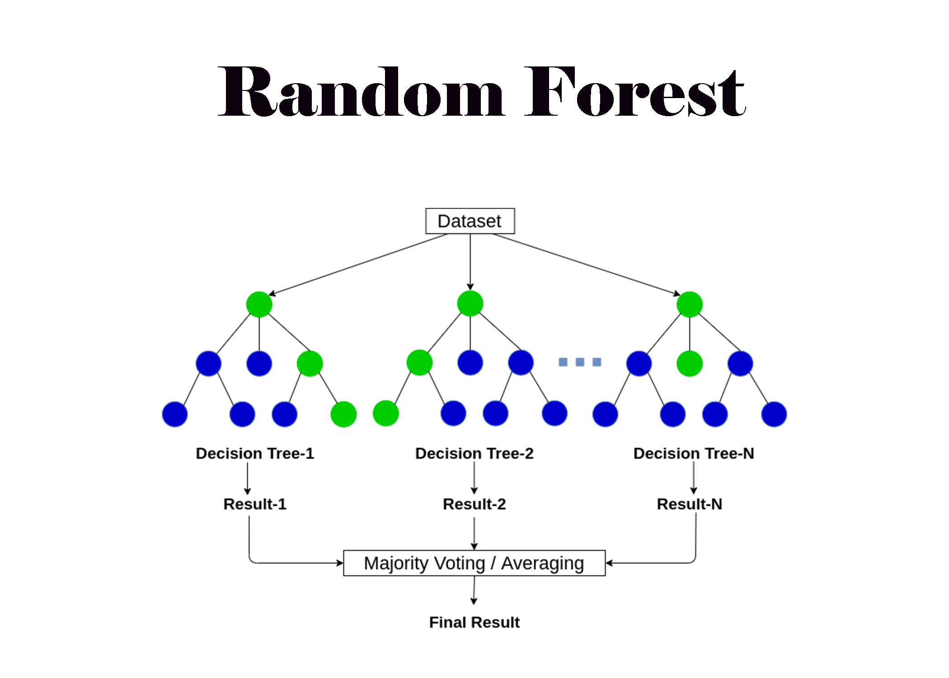

proposed system
The prediction of Botnet attacks using machine learning algorithms provides several benefits, it allows security analysis to detect and respond to potential botnet threats in a proactive manner, mitigating the risk of damage and disruption caused by botnet attacks and also helps in identifying compromised IOT devices and taking appropriate actions to secure them, such as applying security patches, updating firmware or isolating the devices from the network.
Algorithms Used in Proposed system are
Random Forest Algorithm
Support Vector Machine

Slide 10
advantages
Advantages of Proposed System:
Efficient on large datasets
It provides stable and high accuracy
It handles wide data
Effective in high dimensional spaces
Handles Imbalanced Data

Slide 11
Objectives
• Create machine learning models for early botnet attack detection on IoT devices.
Identify botnet threats early to minimize device impact.
Implement quick alerts and preventive measures upon detecting botnet attacks.
Ensure models can adapt to new and evolving botnet attack strategies
Ensure practical usability and user-friendly implementation in real-world IoT scenarios.
Validate the machine learning models using diverse datasets that represent various types of IoT devices, communication protocols, and realistic botnet attack scenarios.

Slide 12
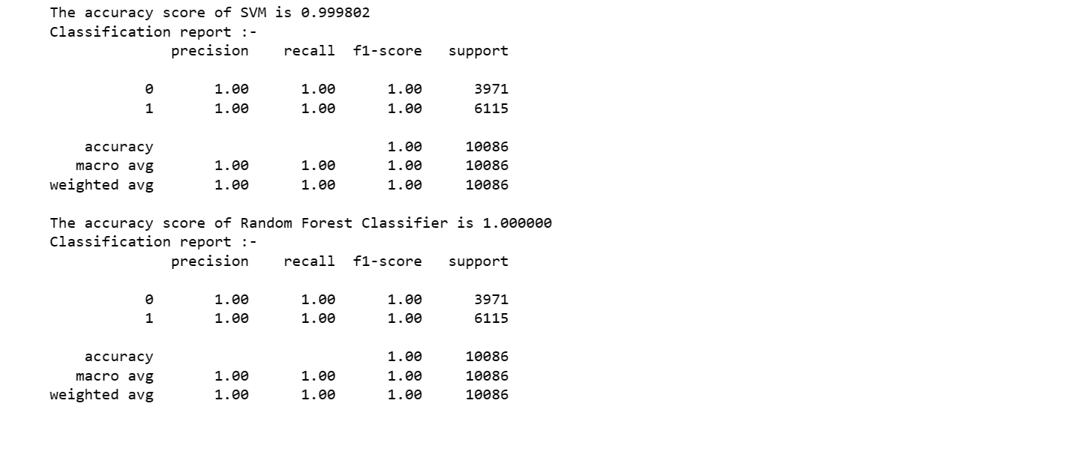
Evaluation Metrics

Slide 13
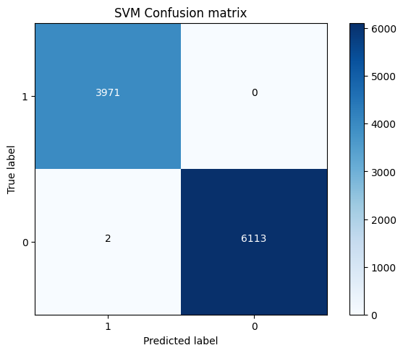

Confusion Matrix

Slide 14
requirements
Hardware Requirements:
• Operating system : Windows, Linux
• Processor : minimum intel i3
• Ram : minimum 4 GB
• Hard disk : minimum 250GB
Software Requirements:
• Python IDLE 3.7 version (or)
• Anaconda 3.7 (or)
• Jupyter

Slide 15
Conclusion
In Conclusion, the integration of machine learning algorithms for the prediction of botnet attacks on IoT devices signifies a proactive and data-driven approach to cybersecurity. The continuous evolution of these models, coupled with advancements in detection techniques, is crucial for staying ahead of the ever-evolving landscape of cyber threats targeting IoT ecosystems.

Slide 16
Scope
In recent years, the Internet has enabled access to widespread remote services in the distributed computing environment; however, integrity of data transmission in the distributed computing platform is hindered by a number of security issues. For instance, the botnet phenomenon is a prominent threat to Internet security, including the threat of malicious codes. The botnet phenomenon supports a wide range of criminal activities, including distributed denial of service (DDoS) attacks, click fraud, phishing, malware distribution, spam emails, and building machines for illegitimate exchange of information/materials. Therefore, it is imperative to design and develop a robust mechanism for improving the botnet detection, analysis, and removal process

Slide 17
Literature survey
Soe et al. [1] adopted a lightweight detection system with a high performance. The overall detection performance achieves around 99% for the botnet attack detection using three different ML algorithms, including artificial neural network (ANN), J48 decision tree, and Naïve Bayes. The experiment result indicated that the proposed architecture can effectively detect botnet-based attacks, and also can be extended with corresponding sub-engines for new kinds of attacks.
Irfan et al. [2] classified the incoming data in the IoT, contain a malware or not. In this research, this work under sample the dataset because the datasets contain imbalance class. After that, this work classified the sample using Random Forest. This work used Naive Bayes, K-Nearest Neighbor and Decision Tree too as a comparison.
Abu et al. [3] proposed an ensemble learning model for botnet attack detection in IoT networks called ELBA-IoT that profiles behavior features of IoT networks and uses ensemble learning to identify anomalous network traffic from compromised IoT devices. In addition, this IoT-based botnet detection approach characterizes the evaluation of three different machine learning techniques that belong to decision tree techniques
Ahmed et al. [4] proposed a model for detecting botnets using deep learning to identify zero-day botnet attacks in real time. The proposed model is trained and evaluated on a CTU-13 dataset with multiple neural network designs and hidden layers. Results demonstrated that the deep-learning artificial neural network model can accurately and efficiently identify botnets.
Tzagkarakis et al. [5] presented an IoT botnet attack detection method based on a sparsity representation framework using a reconstruction error thresholding rule for identifying malicious network traffic at the IoT edge coming from compromised IoT devices.

Slide 18
REFERENCES
S. Dange and M. Chatterjee, "Iot botnet: The largest threat to the iot network" in Data Communication and Networks, Cham, Switzerland:Springer, pp. 137-157, 2020.
Soe YN, Feng Y, Santosa PI, Hartanto R, Sakurai K. Machine Learning-Based IoT-Botnet Attack Detection with Sequential Architecture. Sensors. 2020; 20(16):4372. https://doi.org/10.3390/s20164372
Irfan, I. M. Wildani and I. N. Yulita, "Classifying botnet attack on Internet of Things device using random forest", IOP Conf. Ser. Earth Environ. Sci., vol. 248, Apr. 2019
Ahmed, A.A., Jabbar, W.A., Sadiq, A.S. et al. Deep learning-based classification model for botnet attack detection. J Ambient Intell Human Comput 13, 3457–3466 (2022). https://doi.org/10.1007/s12652-020-01848-9

Slide 19
Thank You ☺

